Slide 1
REEDY LION
FOOTBALL
2023
“W.I.N.”

Slide 2
Reedy Football Staff
Offensive Coaches
Will Secord – Co - OC / QB’s
Brian Chandler – Co - OC / OLine
Trevis Kahle - RB’s
Brad Sicula – Rec’s
Clint Coffman – O-line
Defensive Coaches
Brad Lagrone - DC / LB’S
Jerry Hanlin - DE’S
Jon Zoda - DL
Shaylon Carter - Safeties
Garrett Burns – Corners
Freshman Coaches
Caleb Wells – Head Coach / OC Caleb Zoda - DC

Slide 3
SPORTSYOU
All football communication will be pushed through this application!
Must sign up for main page Reedy Football, and corresponding team page (Freshman, JV, Varsity)

Slide 7
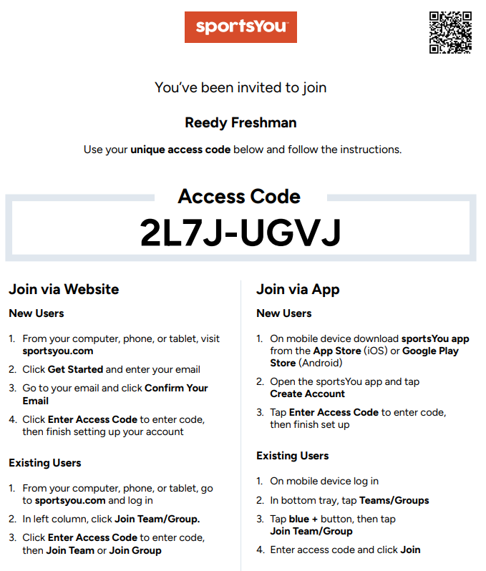

Slide 8
Athletic Training
CyAna Roe
Roec@FriscoISD.org
John Hicks
HicksJ@FriscoISD.org
If ever any question concerning paperwork and/or injury please contact us
Encourage your child to communicate if they are hurt.
Treatments will be every morning in the Gym Athletic Training room.
If injured – come in for treatment. If not coming in, expected to participate.
Concussions:
Complete your Impact Concussion test
UIL/FISD concussion treatment and protocol is very specific -part of the process is having the Impact test completed before participating in the contact sport.
RankOne paper work
FISD carries a secondary insurance policy for injuries that take place at school. Extra coverage is available for 24/7 accident coverage. If interested please contact us.

Slide 9
Team Physician
Christopher Redman, M.D. Board Certified Orthopaedic Surgeon Pediatric Sports Medicine and Spinal Deformity andrewsinstitute@childrens.com www.childrens.com/andrews
7211 Preston Road Plano - Texas - 75024 (P) 469.303.3000 (F) 469.303.4510

Slide 10
Football & Injuries
Communicate
Use our resources
Stay on the same page

Slide 11
REEDY 2023
“W.I.N.”
PRESENTED BY:
Chris Bush

Slide 12
Practice Plan In-Season
VARSITY / JV PRACTICE:
6:30 am to 8:15 am PRACTICE
Film / Weights during the 4th period block
FRESHMAN PRACTICE:
2:55 pm START OF 4TH PERIOD
3:00 to 4:30 pm PRACTICE – Monday - Wednesday
4:30 to 5:15 pm WEIGHTS – Monday & Wednesday
Friday – Var Game Day, FR will lift and be dismissed at the end of period. 4:25
**No morning practice on Game day and day after.
** VARSITY
11:00 am Saturday morning. Varsity ONLY

Slide 13
Accountability
Players please notify coaches if student athlete will be missing practice. This includes Saturday in – season schedule (Varsity Only)
Coaches office is 469-633-6470.
colec@friscoisd.org- Varsity and JV
wellscal@friscoisd.org - Freshman
Missed practices will need to be made up before Student athlete is allowed to participate in the next week’s contest.

Slide 14
No male or female athlete may quit a sport (in season) and join another sport (off season) until the current sport that he or she left has concluded.
Exception – coach from current in season sport and upcoming season sport agree to athlete moving to next sport with communication with campus coordinator is in the best interest of athlete.

Slide 15
FISD Lettering Policy

Slide 16
Equipment Coordinators
Var – Coach Kahle
JV – Coach Hanlin
Fr. – Coach Caleb Zoda

Slide 17
What we provide
Any other items must be approved to be worn during practices/games.
Athletes will be required to turn in the equipment issued to them at the end of the season.
Helmet
Shoulder Pads
Practice Jersey
Practice Pants
Girdle
Workout Shirt
Workout Shorts
Practice Socks
Towel
Mouthpiece

Slide 18
Colors/Laundry
School colors are Hunter Green, Silver, and Navy Blue
Laundry will be washed for the players and returned to their lockers prior to practices. It is the athlete’s responsibility to get items to be washed onto their laundry clips and into the basket for cleaning.

Slide 19
REEDY LIONS COLLEGE RECRUITING INFORMATION

Slide 20
UNDERSTANDING RECRUITING
A GUIDE FOR THE COLLEGE BOUND STUDENT ATHLETE

Slide 21
THE RECRUITING PROCESS
HIGH SCHOOL COACHES DO NOT OFFER AND SECURE SCHOLARSHIPS FOR ATHLETES. SCHOLARSHIPS ARE ONLY OFFERED BY COLLEGE COACHES AND RECRUITERS. REEDY COACHES WILL ALWAYS HELP IN ANY WAY THEY CAN TO PROMOTE ATHLETES AND OUR HIGH SCHOOL FOOTBALL PROGRAM. REEDY COACHES WILL ALWAYS BE HONEST AND STRAIGHTFORWARD WITH COLLEGE COACHES, STUDENT ATHLETES AND PARENTS. THE RECRUITING PROCESS CAN BE AN EXCITING TIME IN A STUDENT ATHLETES LIFE, BUT FOR MOST, IT IS A STRESSFUL AND CONFUSING TIME FOR BOTH THE STUDENT ATHLETE AND THE PARENTS. COLLEGES HAVE A LIMITED NUMBER OF SCHOLARSHIPS EACH YEAR AND THEY ARE LOOKING FOR SPECIFIC MATCHES FOR THEIR PROGAM. THE RECRUITING PROCESS USUALLY TAKES TIME AND EFFORT FROM THE STUDENT ATHLETE. THE SCHOLARSHIP OFFER IS ULTIMATELY BETWEEN THE STUDENT ATHLETE AND THE COLLEGE COACH, LEAVING HIGH SCHOOL COACHES AND PARENTS OUT OF THE EQUATION.

Slide 22
3 QUESTIONS
Are you the best player on the Team?
Are you one of the Top 10 players in the District?
Are you one of the Top 10 Players at your position in DFW area?
-If you can’t answer “YES” to each question, you might not be playing at major D1 Conference, but there are plenty of opportunities at the D2, D3, JC, NAIA levels

Slide 23
RECRUITING
UNDERSTAND THAT RECRUITING IS BASICALLY COLLEGE FOOTBALL PROGRAMS SHOPPING FOR THEIR PLAYERS. THEY HAVE DIFFERENT EXPECTATIONS ON EACH POSITION AND THEY DO NOT ALWAYS MATCH EACH OTHER. EXAMPLE: SOME SCHOOLS WANT TIGHT ENDS THAT ARE AT LEAST 6’4” SO IF WE HAVE A GOOD TIGHT END THAT IS 6’2” THEY WILL NOT EVEN TALK TO THAT INDIVIDUAL. MANY TIMES THEY ARE INITIALLY LOOKING AT MEASURABLES AND NOT INTANGABLES. (SIZE, STRENGTH, SPEED AND GRADES)
THEY DO NOT TALK TO ANYONE WHO DOES NOT FIT THEIR MEASURABLE EXPECTATIONS. THERE ARE A TON OF GREAT HIGH SCHOOL ATHLETES WHO ARE 5’9” AND RUN A 4.6 IN THE 40. MOST OF THEM DO NOT GO AND PLAY DIVISION 1 FOOTBALL.
IF A PLAYER REALLY WANTS TO PLAY COLLEGE FOOTBALL THERE ARE OPPORTUNITIES AT DIFFERENT LEVELS. THEY MIGHT NOT PLAY ON TV EVERY WEEK BUT THEY CAN PLAY A HIGH LEVEL OF FOOTBALL.
DIVISION 2, DIVISION 3 AND NAIA ARE LEGITIMATE FOOTBALL. IF YOU HAVE NEVER WATCHED A GAME AT THESE LEVELS WE HIGHLY RECOMMEND THAT YOU GO WATCH A GAME FOR YOURSELVES.

Slide 24
RECRUITING MYTHS
BAD GRADES WON’T MATTER IF YOUR TALENT IS GOOD ENOUGH.
If I hire a recruiting service they will get me a scholarship.
My highlight film will get me a scholarship.
Post Season Accolade’s will get me a scholarship

Slide 25
ENJOY YOUR TIME BEING A REEDY LION!
HIGH SCHOOL FOOTBALL IS ONE OF THE GREATEST TIMES OF LIFE, YOU MAKE LIFELONG FRIENDSHIPS AND LEARN ABOUT YOURSELF AND BEING PART OF A TEAM.
WITH TEAM SUCCESS COMES PERSONAL SUCCESS!

Slide 26
RBC SLIDES

Slide 27
PARENT / COACH RELATIONSHIPS AT REEDY HS
Understanding and respecting the position of both parents and coaches will help enhance the athletic experience for our kids.

Slide 28
Playing Time…
Top 3 factors that determine playing time at RHS:
1. Attitude
2. Effort
3. Ability
At Reedy HS we have Great Kids and all of our Kids work extremely hard…
We spend all offseason insuring everyone meets this requirement.
So then, what is next…
We Have to be Allies in this process, Not Enemies!
I WILL talk about playing time, if you are willing to hear what is being said..

Slide 29
Do your Job!
Coaches Coach
Players Play
Parents parent
Officials officiate
“Positive Coaching Alliance”
Please refrain from destroying…
Your son’s confidence
His ability to form his own opinions
His ability to fix his own problems
“Commonly known as Dinner Table Destruction”

Slide 30
If you feel that a conference is necessary, please use the following procedure:
Call the Coach
Set up an Appointment
If the Coach cannot be reached, call the Campus Coordinator at 469-633-6470 and request a meeting
Please do not attempt to confront a coach before or after a contest or practice. Emotions are running too high and do not promote positive results or resolutions.
*** Nothing really gets solved over Email!

Slide 31
Parent Code Of Conduct:
Make sure your child knows that you love him or her, win or lose
Be realistic about your child’s athletic ability
Emphasize improvement
Don’t live through your kid. Your playing days are over!
Control your emotions. Please do not come to the fence to talk to your son on the sideline
Be an encourager
Respect coaches – communicate with them in a positive way and encourage others to do the same
Be a role model
Get to know other kids on the team
“Support the Pride”

